Slide 1
Online Finance Management
Web Development Project – Summer 1
Dhavalkumar Patel
MS in Computer Science (Graduate)
Email: patel.dha@husky.neu.edu
NUID: 001665804

Slide 2
Problem & Solution Statement
Managing Personal Finance
Centralized access to all Finance Accounts

Slide 3
Technology Stack
User Interface: HTML, CSS, Bootstrap
Client Side Development: Jquery, AngularJS
Server Side Development: NodeJS
Database: MongoDB
Security: Passport Authentication
Third Party API: YODLEE (https://www.yodlee.com)

Slide 4
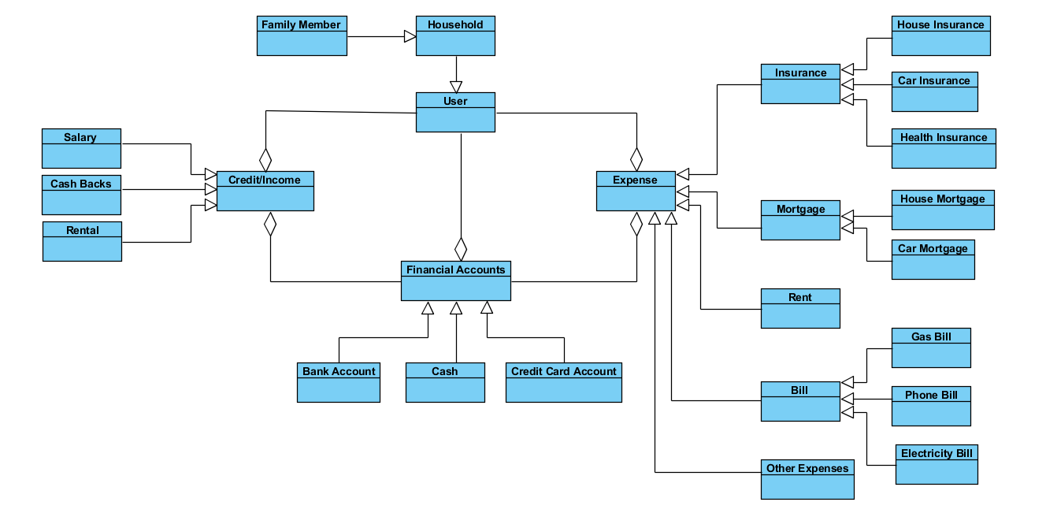
Data Model

Slide 5
Demo
Roles
Role 1 – House Hold
Role 2 – Family Member
Other roles – Admin, Anonymous(not logged in)
Users
Family One: alice/alice is HouseHold & bob/bob is Family Member
Family Two: charlie/Charlie is HouseHold & dan/dan is Family Member
Admin: admin/admin

